Slide 1
ON TO 2050 Development
Chicago Regional Greenhouse Gas Emissions Inventory
Metropolitan Mayor Caucus, Environmental Committee
June 19, 2018
Notes:
First talk about process
Then talk about key findings

Slide 2
Agenda
Project scope
Inventory results
Takeaways
Notes:
Notes:
Nature of the memo – more info to come.
Web-based plan means that stakeholders will not access this information linearly.
Expand recommendations to guide development patterns that support reinvestment, fiscal sustainability, economic growth, existing infrastructure, and a strong quality of life

Slide 3
Greenhouse Gas Emission Inventory Project scope

Slide 4
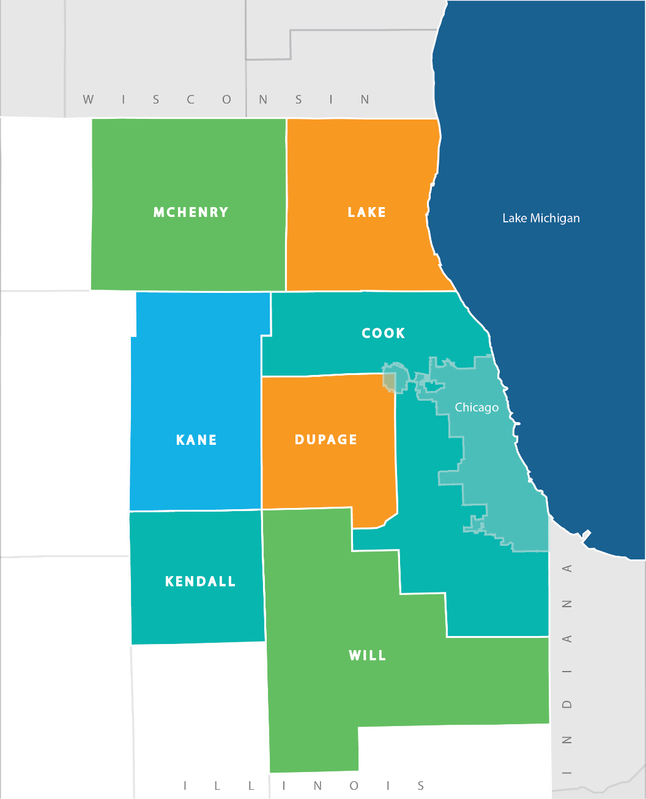
Project scope
New inventory for 2015
Updated inventory for 2010
GPC-compliant
7 Counties and the City of Chicago

Slide 5
Project scope
Contracted with ICF
GPC Basic
Sector | Scope 1 | Scope 2 | Scope 3
Stationary Energy | ✓ | ✓ | NE
Transportation | ✓ | ✓ | NE
Waste | ✓ | NA | ✓
Industrial Processes and Product Use | NE | NA | NE
Agriculture, Forestry and Other Land Use | NE | NA | NE

Slide 6
Greenhouse Gas Emission Inventory Results

Slide 7
Results
2015 Regional Emissions by Sector
Sector | Total by Scope |  |  | BASIC Total
 | Scope 1 | Scope 2 | Scope 3
Stationary Energy | 32.29 | 49.61 | NE | 81.90
Transportation | 34.13 | 0.35 | NE | 34.48
Waste | 1.42 | NA | 2.01 | 3.43
Total | 67.84 | 49.96 | 2.01 | 119.81

Slide 8
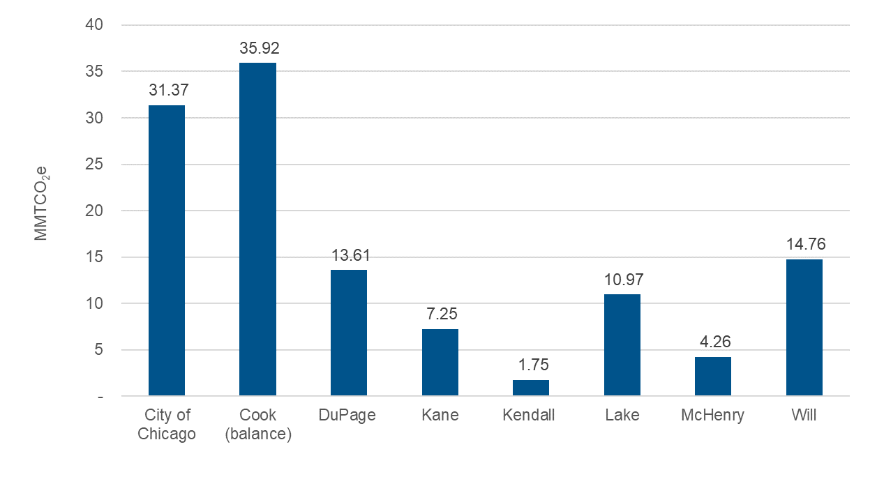
Results
2015 Total Emissions by County

Slide 9
Results
2015 Per Capita Emissions by County

Slide 10
Results
2010 Regional Emissions by Sector
2010-2015 comparison

Slide 11
Results
2015 Per Capita Emissions by County

Slide 12
Greenhouse Gas Emission Inventory Takeaways

Slide 13
Takeaways
Start the data collection as early as possible
Especially for utilities
Significant sources of emissions are not included at the GPC Basic level
The report is likely undercounting emissions
Consider GPC Basic+ for smaller areas
Notes:
Notes:
Nature of the memo – more info to come.
Web-based plan means that stakeholders will not access this information linearly.
Expand recommendations to guide development patterns that support reinvestment, fiscal sustainability, economic growth, existing infrastructure, and a strong quality of life

Slide 14
Thank you!
Jared Patton jpatton@cmap.Illinois.gov

