Slide 1
Clean Energy Options for GRC Communities
The power Bureau
September 18, 2018

Slide 2
Overview
Objectives
Background
Options
Approaches
Discussion

Slide 3
Objectives
Level set knowledge to inform expectations
Acknowledge differences in clean energy options and baselines
Consider different approaches available to municipalities
Start a longer term discussion

Slide 4
Background: Illinois Energy Portfolio

Slide 5
Background: Who Determines Options
Market Participant | Electricity System Sector
 | Generation | Transmission | Distribution
Asset Owners | Independent Power Producers | Electric Distribution Companies | Electric Distribution Companies
 | - Purchase generation fuels | - Key role in planning process | - Plan, build and own system
 | - Generate electricity | - Build, own, maintain transmission | - Plan, build, own, and maintain distribution equipment
 | - Sell electricity into grid
System Operators | PJM / MISO | PJM / MISO | Electric Distribution Companies
 | - Administers wholesale markets | - Plan new transmission | - Enter supply agreements for default rate customers
 | - Ensures resource adequacy | - Operates system for reliability
 | Retail Suppliers - Purchase electricity from wholesale Producers and sell to consumers |  | - Meter and bill customers - Monitor distribution system - Administer efficiency programs - Coordinate with retail suppliers
Regulators | FERC | FERC | Illinois Commerce Commission
 | - Regulates wholesale markets | - Regulates rates | - Adjudicates complaints
 | - Conducts investigations | - Sets and enforces reliability standards Illinois Commerce Commission - Approves project routes | - Regulates and approves rates
 | - Approve System Operator's market rules Illinois Commerce Commission - License suppliers U.S. EPA, IL EPA, PCB - Promulgate and implement environmental regulations |  | - Reviews compliance - Approves energy efficiency Plans

Slide 6
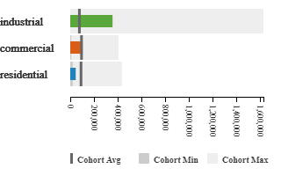
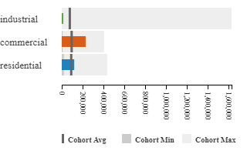
Background: Consumption Baselines
Franklin Park
Park Ridge

Slide 7
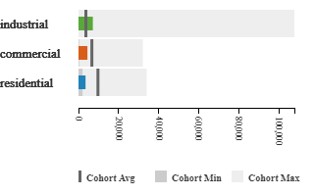
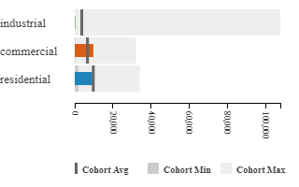
Background: Cost Baselines
Franklin Park
Park Ridge

Slide 8
Options: Clean Energy for Municipalities
Clean Energy
Renewable Supply
Generation
Efficiency
Reduction
Purchasing
Behind the Meter
Renewable Energy Credits
Community Solar
Utility Scale
Load Shifting
Transportation
Demand response
Equipment/Systems
Behavior
Battery Storage

Slide 9
Options: Municipal Action on Clean Energy
Purchase
LED Streetlights
Sponsor
Municipal Aggregation
Influence
Building Codes
Zoning Process
Permitting Process
Group Purchasing Programs
Sourcing Platforms
Community Solar
Solar/Efficiency at municipal facilities

Slide 10
Options: Simple Municipal Action Matrix

Slide 11
Approach: Clean Energy Programming
Objectives
Data driven
Policies set with specific goals in mind
Standardized M & V protocol
Third-party data use (utility, DOE, etc.)
Localized
For specific municipal account portfolios
Sector-specific plans and programs
Economic Element
Cost / Benefit evaluation for Programs
Prioritization for local development/benefits

Slide 12
Approach: Clean Energy Programming
Objectives
Metrics
Data driven
Policies set with specific goals in mind
Standardized M & V protocol
Third-party data use (utility, DOE, etc.)
Localized
For specific municipal account portfolios
Sector-specific plans and programs
Economic Element
Cost / Benefit evaluation for Programs
Prioritization for local development/benefits
Consumption Reduction
Over time (annual and cumulative)
vs. State, utility region, etc.
Cost per Measure
$/MWh avoided energy consumption
$/MWh new clean energy generation
Emissions
Over time (annual and cumulative)
Factored for changes in regional generation portfolio

Slide 13
Approach: Clean Energy Toolbox
Local Clean Energy Plan
Data
Analytics
Legal
Procurement
Reporting
Management
Services & Assistance for Municipalities
Cross-cutting
Pooled internal resources
Pooled external resources
a la carte
Outputs
Shared local program results
Appropriate benchmark methodology
General reporting on progress

Slide 14
Thank You Very Much
Mark J. Pruitt
The Power Bureau
E. markjpruitt@thepowerbureau.com
P. 219/921-3828

