Slide 1
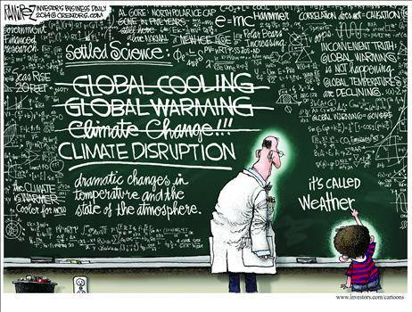
Understanding the Science of Climate Disruption
Doug Sisterson
Environmental Science Division
Argonne National Laboratory
Mayor’s Caucus, August 31, 2017

Slide 2
https://www.youtube.com/watch?v=7_CzMjrhawY

Slide 3
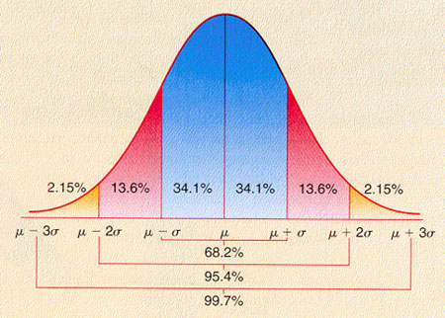
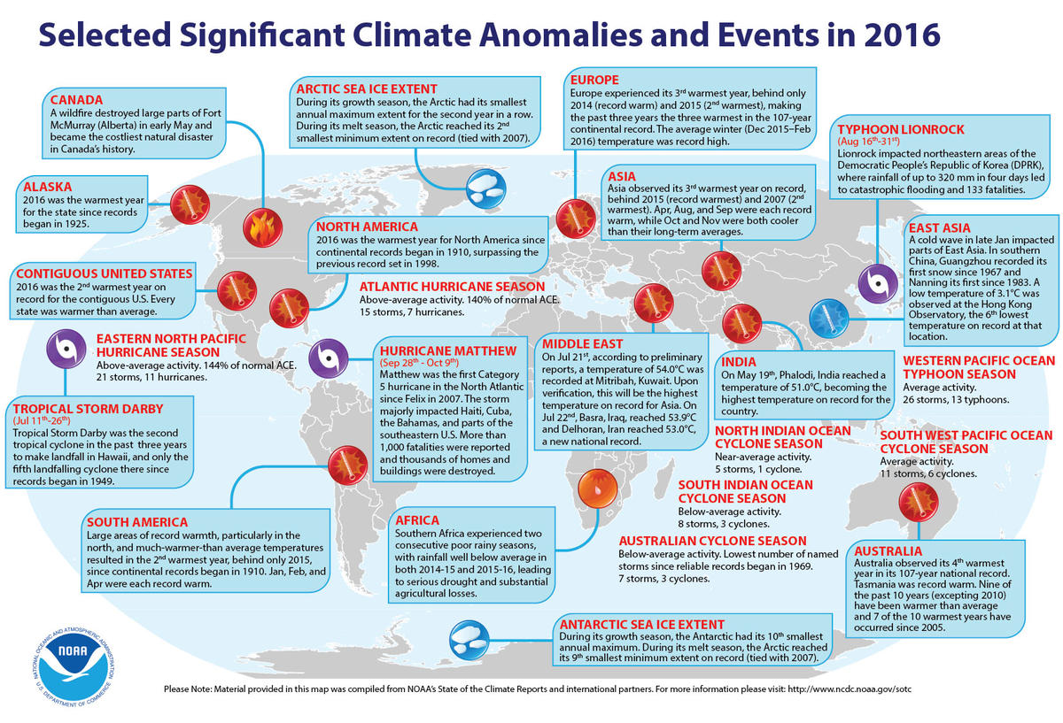
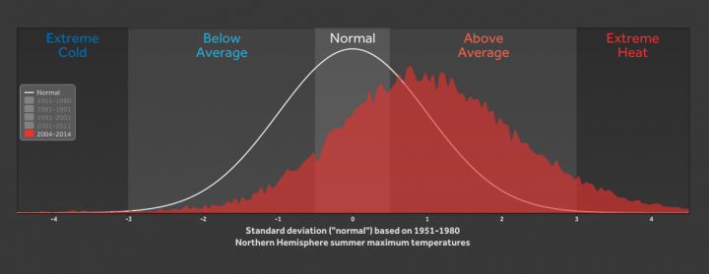
Weather Extremes: Not just Heat Waves! The Weather Point of View
Weather patterns used to be known, and more predictable.
Weather extremes are becoming more frequent and less predictable!

Slide 4
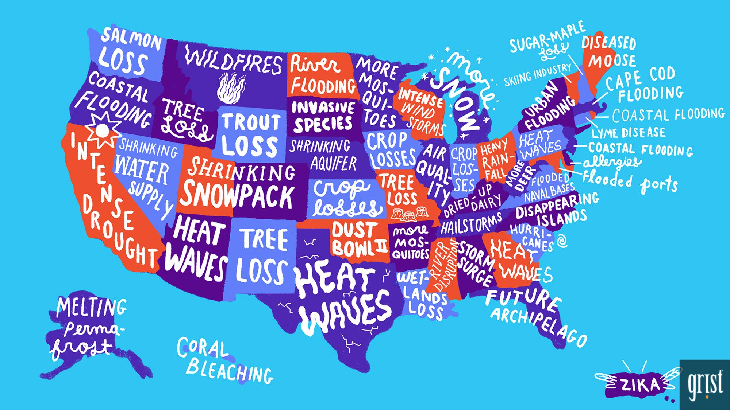
Impacts closer to home!
Grist is an American non-profit online magazine that has been publishing environmental news and commentary since 1999.

Slide 5
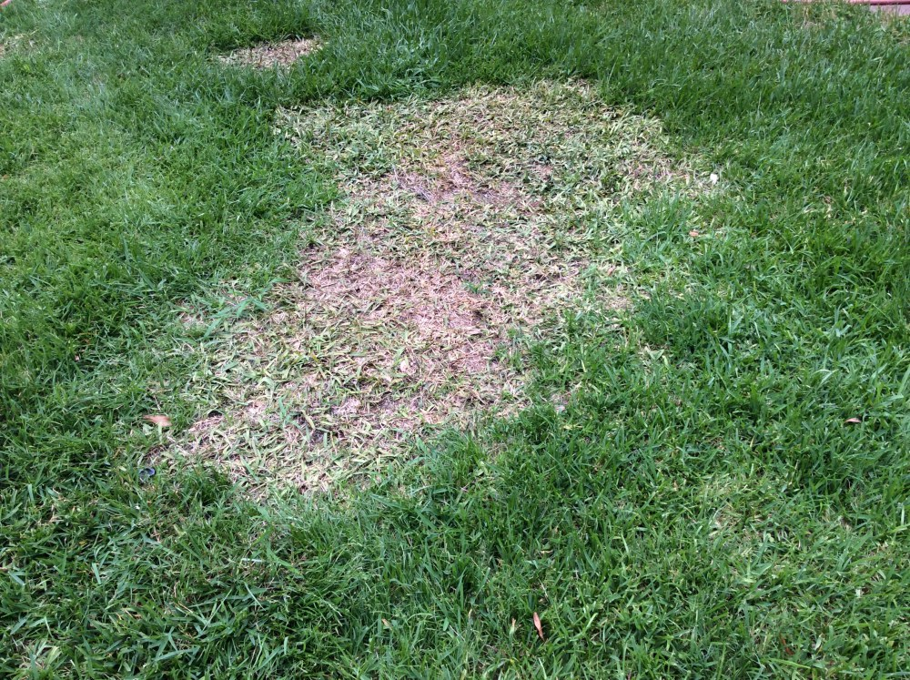
Impacts really close to home!
More flooding rains
More powerful tornadoes, winds, and hail storms
Diseased grass
Diseased Austrian Pines
Ticks!
Green Ash trees meet the Emerald Ash Bore

Slide 6
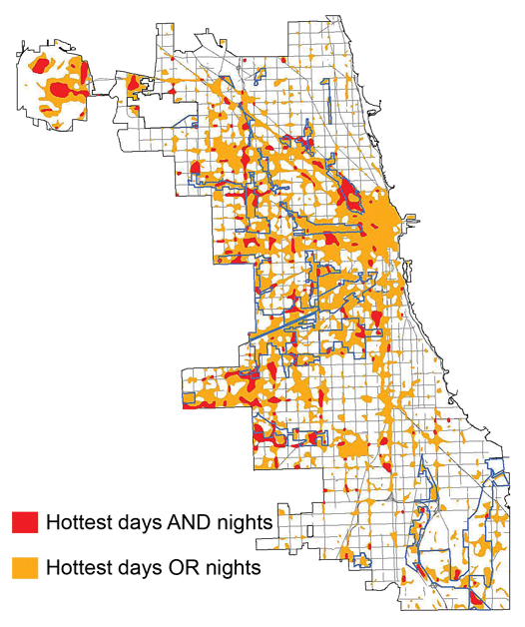
Another Wrench!
Chicago
Overall, urban areas do not significantly impact global warming, but global warming has a huge impact on the urban microclimate!
The National Weather Service locates official reporting stations in representative areas (in open spaces, not next to buildings, over a grassy field and not asphalt).
Urban areas can be more than 10 F warmer (daytime and nighttime) than the suburbs and rural areas!
Heat waves are likely to be more intense in the city where most people live!
http://globalchange.gov/publications/reports/scientific-assessments/us-impacts/regional-climate-change-impacts/midwest (2009)
Notes:
Shown here is the frequency at the end of the century of what we consider now to be a 20 year heat wave. Instead of once every 20 years, these temperatures would be experienced every other year or so over most of the continental US in this business as usual scenario.

Slide 7
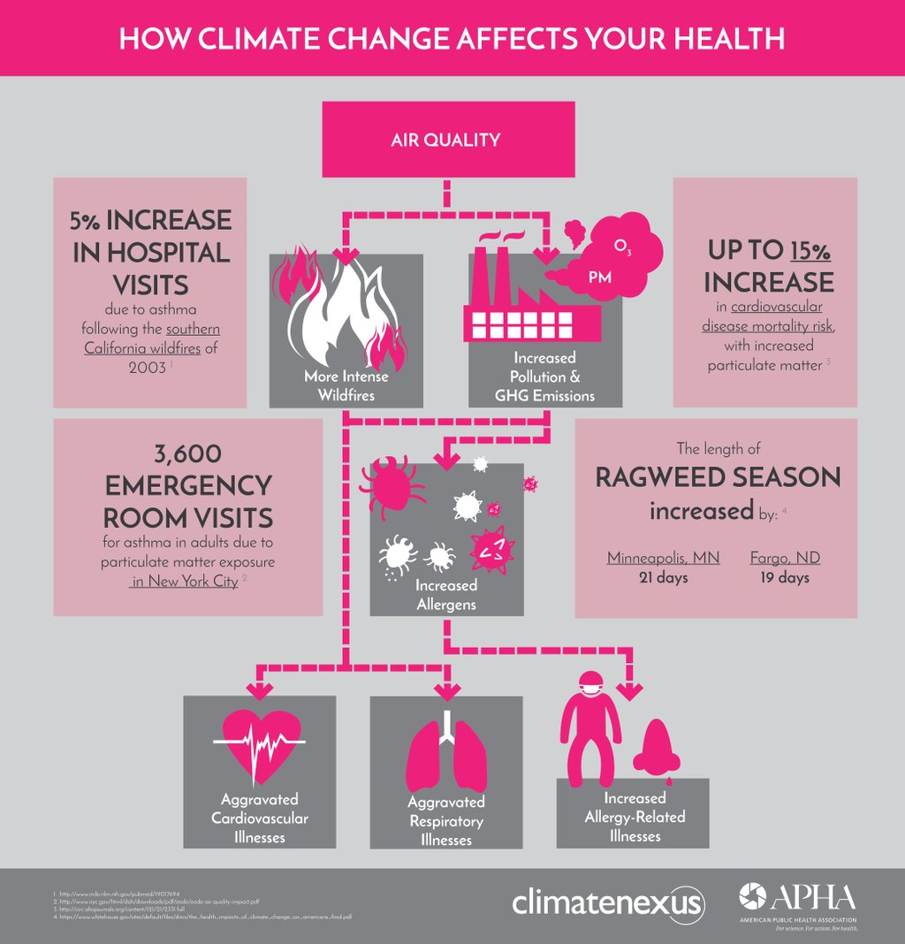
Impacts at Home!
Increased :
Allergies
Respiratory stress
Cardiac stress
All due to increased anthropogenic greenhouse gasses as a pollutant!
Global warming will have a significant impact on the health on those living in urban micro climate!
Most of the world’s population lives in cities!

Slide 8
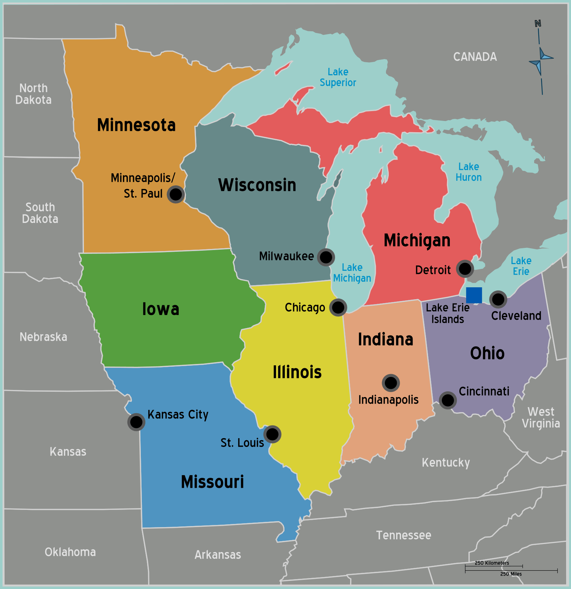
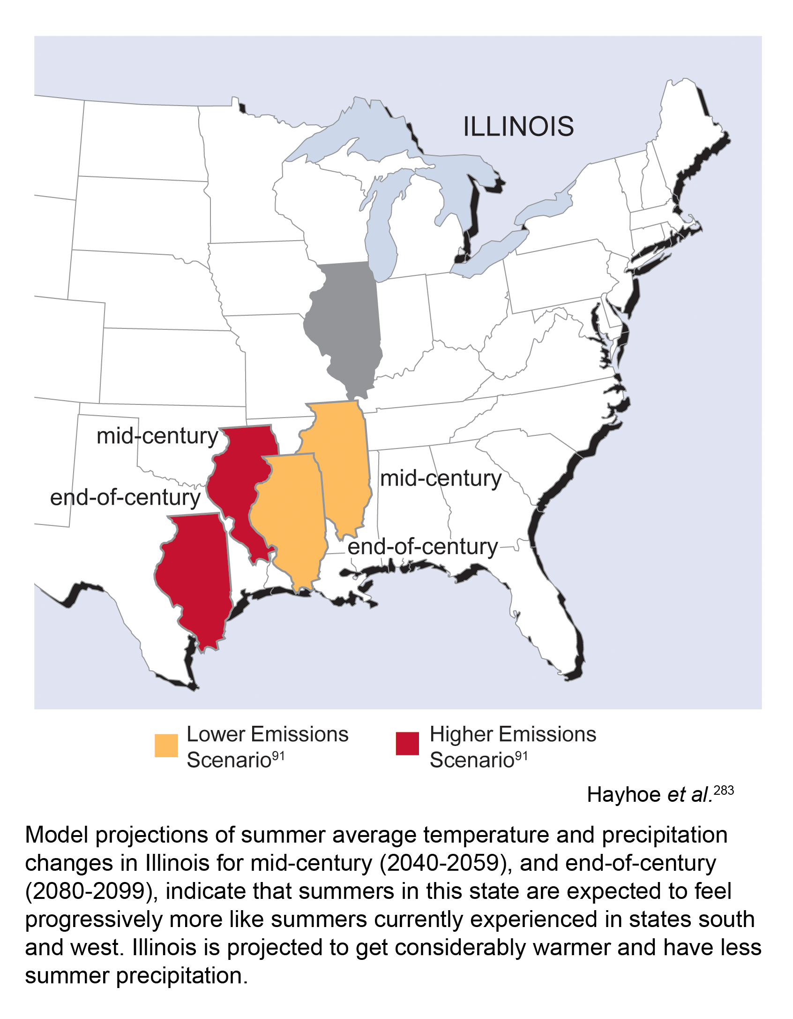
What Might Home Look Like at the End of the Century?
What is the Impact of Global Warming in the Midwest?
Think Houston Texas!
Scientists have NOT reached consensus on timing or regional impact, but we are getting some ideas.

