Slide 1


Mayors Climate Forum
Global threat. Local action
August 31, 2017

Slide 2
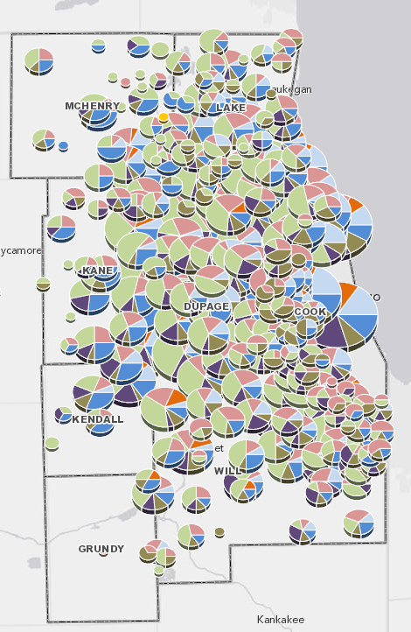
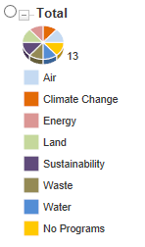
Current Environmental Actions by MMC members
Notes:
We analyzed what communities are already doing. 81% are making substantial efforts already

Slide 3
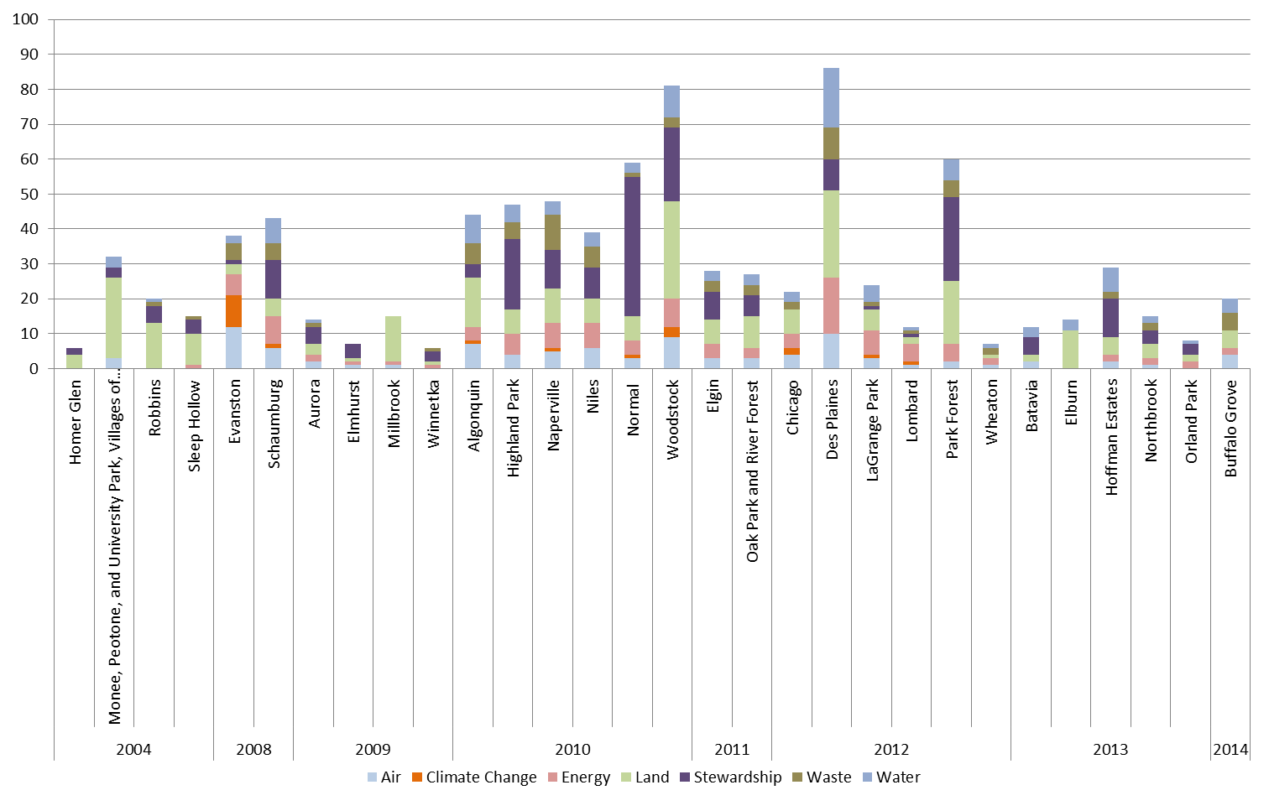
GRC2 is Made From all Municipal & Regional Sustainability Plans
Notes:
We studied all existing sustainability plans – local and national or regional

Slide 4

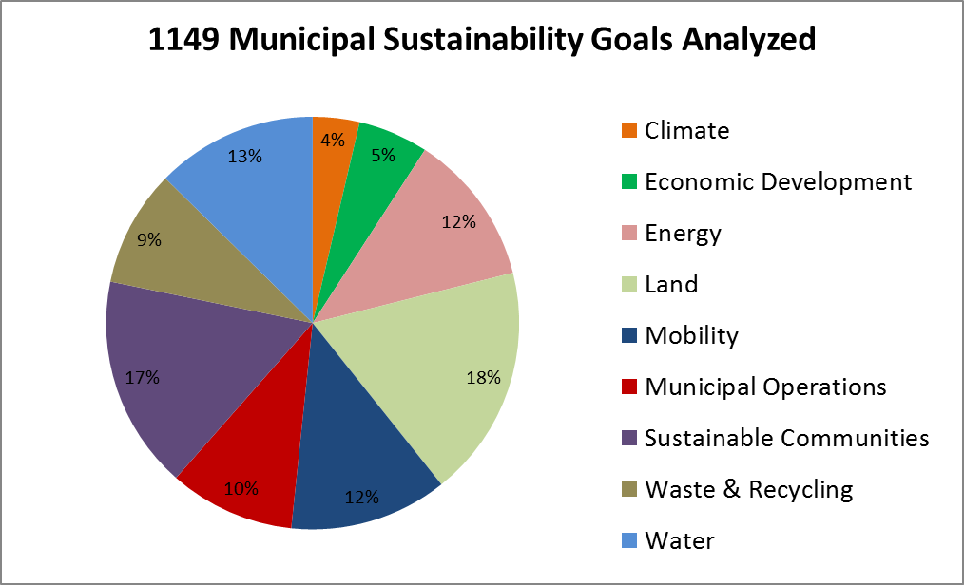

Consensus GRC2 Goals
From ALL Sustainability Goals
To GRC2 Goals
Notes:
This all got synthesized into the Greenest region Compact 2

Slide 5











Part 1 -The Greenest Region Compact 2
Consensus Sustainability Goals in 10 Categories
Climate
Economic Development
Energy
Land
Leadership
Mobility
Municipal Operations
Sustainable Communities
Water
Waste

