Slide 1
Adopters
Notes:
Please join us. We are taking climate action. = reducing emissions, saving money, improving quality of life

Slide 2
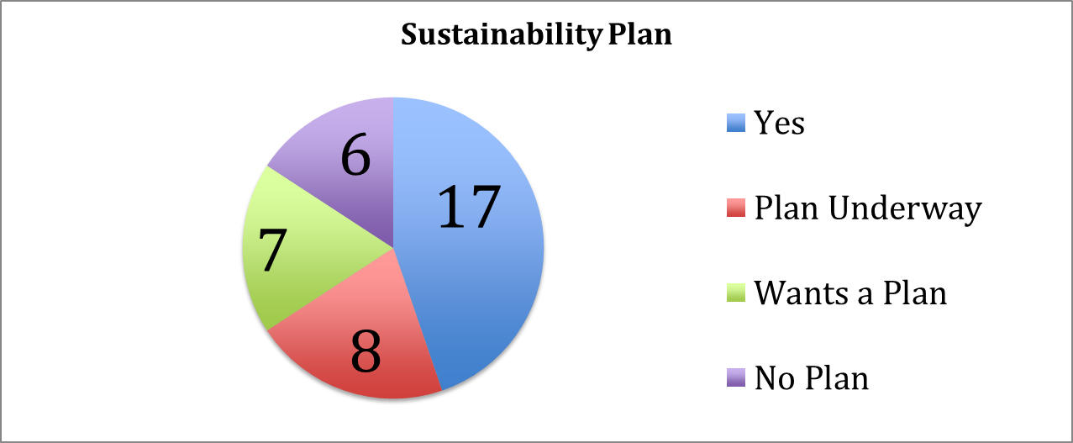
GRC2 Framework
Municipalities present today
Simplifies Sustainability planning
Notes:
15 f communities here today reported they want a sustainability plan. The GRC2 will make it easy.

