Slide 1
Environment Committee Designing an EV Ready Program November 12, 2019

Slide 2
Agenda
Why Become EV Ready
Technical Background
Dialogue: Listening
Next Steps

Slide 3
Why Become EV Ready?

Slide 4
Greenest Region Compact Mobility & Municipal Operation Goals
Support efficient transportation that uses resources wisely
Integrate sustainability into transportation policies, programs and regulations
Operate a safe, clean, and efficient fleet
Formally adopted by:
125 municipalities
3 counties
10 COGs

Slide 5
Environment Committee working towards EV Readiness
Green fleet research and partnerships
Survey
Municipal Fleet Managers Association
Proposed regional alternate fuel study
Discussions and analysis of VW mitigation settlement
Interest in EVs for the community & fleet emerged
Success with SolSmart – streamlining municipal codes & policies

Slide 6
Funding & Policy Support for Electrification of Transportation
Proposed Clean Energy Jobs Act (CEJA) supports electrification
Environmental Advocacy for EVs
Widely supported climate solution
Current funding support
Federal tax credit - $7,500
Anticipated funding support
VW Settlement – up to $16 million
Capital bill - $70 million
Possible/hopeful funding support
Congestion Mitigation Air Quality (CMAQ) competitive funds
Drive Clean Chicago Incentives

Slide 7
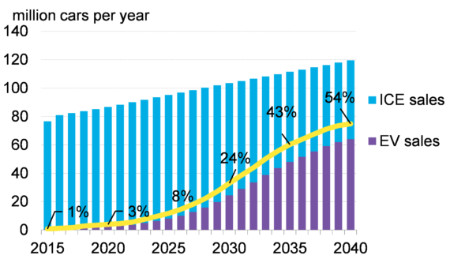
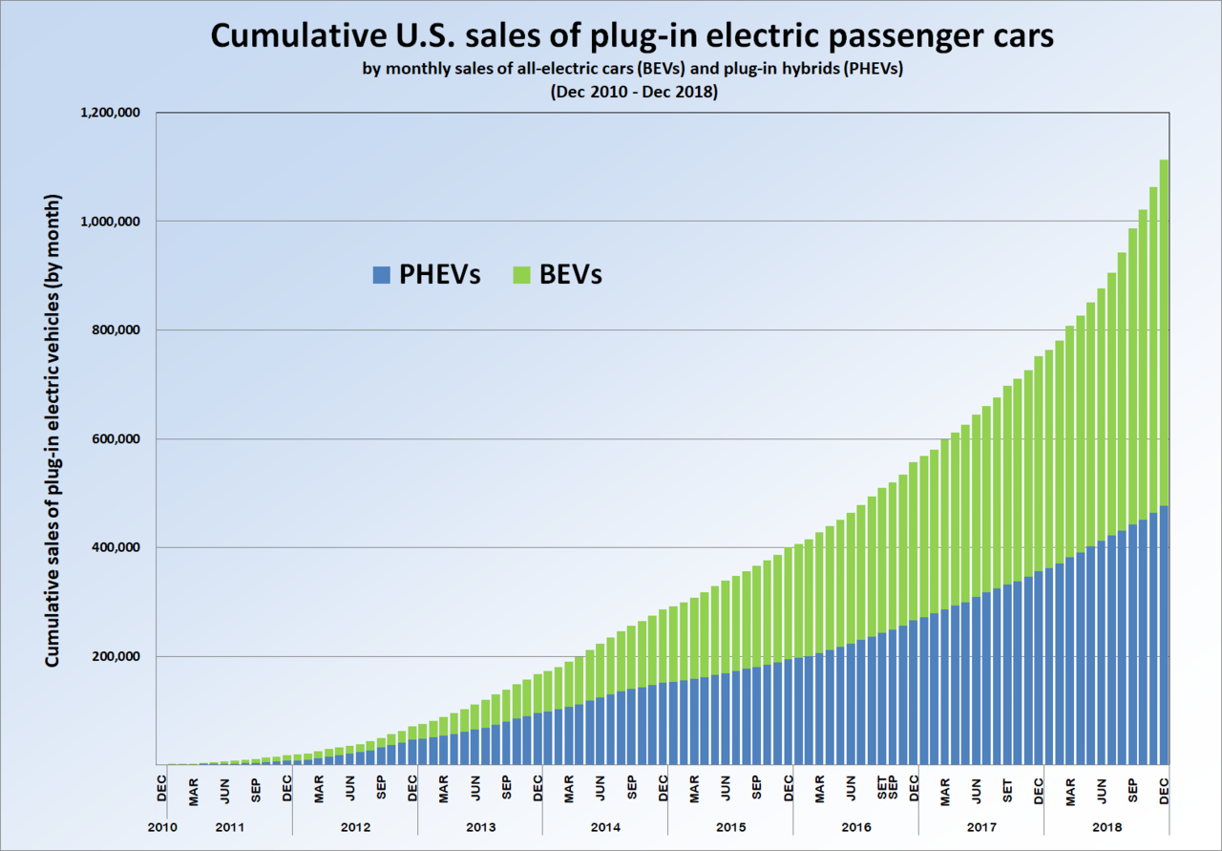
Key Driver: EV Market Demand
ICE = Internal Combustion Engine
New Vehicle Sales Forecast:
Bloomberg
Recent Past statistica.com
Total vehicles (2019)
Global 1.2 billion
US 262 million US
US Vehicles (2019)
Internal Combustion Engines (ICE): 260 million
EVs: 1.5 million
Some governments and automakers moving away from Internal Combustion Engines
PHEV = Plug-in Hybrid EV
BEV = Battery Electric EV
Sources: Bloomberg New Energy Finance
Statistica.com

Slide 8
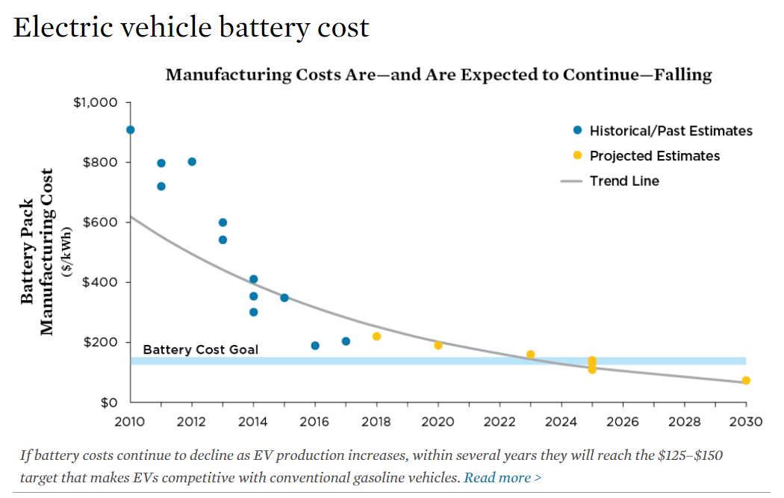
EV Cost Parity Predicted with Internal Combustion Engine Vehicles (ICEVs)s
Reducing battery costs is key
Battery Costs have dropped 3.5:1 since 2010
Estimate: when EV battery costs drop below $100-150/kWh storage → EVs will cost about the same as gasoline counterparts
Expected between 2022 and 2025
Total Cost of Ownership for EV: already better than ICE
Perception: Game Changer once CapEx reaches parity
EVs cost less
$150 = Parity
SOURCES:
ARB 2017; SOULOPOULOS 2017; VOELCKER 2017; SLOWIK, PAVLENKO, AND LUTSEY 2016; VOELCKER 2016; NYKVIST AND NILSSON 2015.
https://www.energy.gov/eere/vehicles/batteries

Slide 9
We need to be EV Ready

Slide 10
To Design an EV Ready Program
Listening sessions
Develop EV Ready Framework/Checklist
Develop EV Ready Buying Decision Guide
Seek funding to develop a more comprehensive EV Ready Program.
Create resources to implement framework/checklist strategies.
Recognition program (i.e. SolSmart)
THANK YOU TO THE JOYCE FOUNDATION!

Slide 11
Technical Background

Slide 12
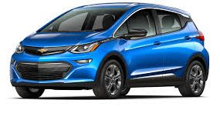
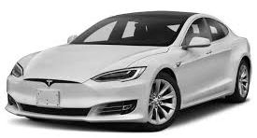
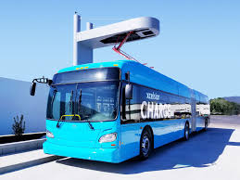
Electric Vehicle Choices
Plug-in Hybrid Electric Vehicles (PHEV) aka Range Extended Electric Vehicles (REEV)
Primary power source is electricity
Internal combustion engine (ICE) automatically engages when battery runs low
Zero tailpipe emissions when running on battery only
ICE feature alleviates range anxiety
All Electric Vehicle (AEV) aka Battery Electric Vehicles (BEV)
100% electric battery powered
Range limited
Zero tailpipe emissions
Quiet
Lower maintenance

Slide 13
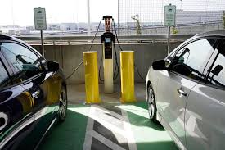
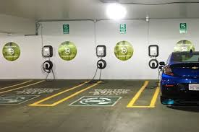
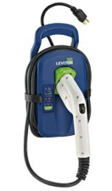
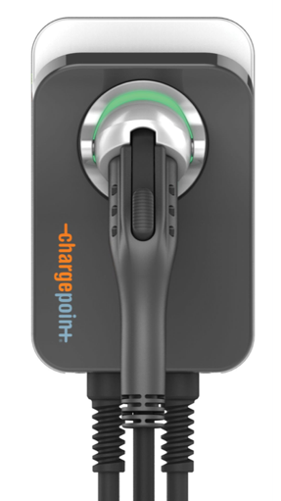
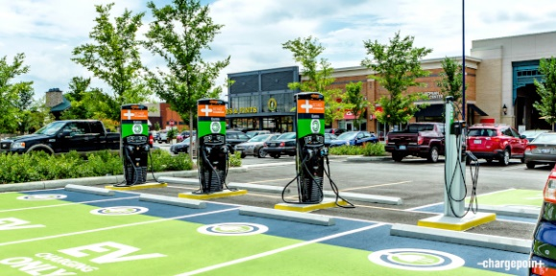
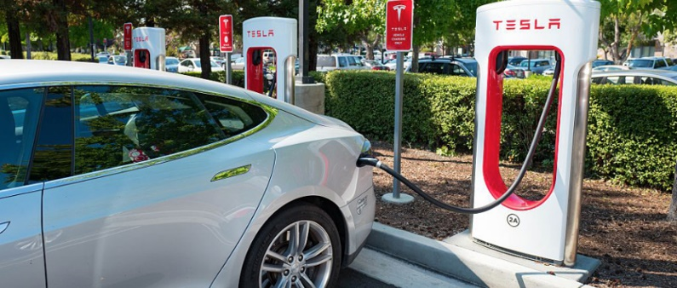
EVSE = Electric Vehicle Supply Equipment aka EV Charger aka EV Charging Station
VAC = Volts Alternating Current
kW = Kilowatt
DC = Direct Current
Mobile / Home Chargers
Level 1:
120 VAC, 1 to 3 kW
Public Chargers
Level 2:
208/240 VAC
7 to 9 kW
DC Fast Chargers
460 VAC
25 to 150 kW
Home/Work Chargers
Level 2:
240 VAC, 4 to 7 kW

Slide 14
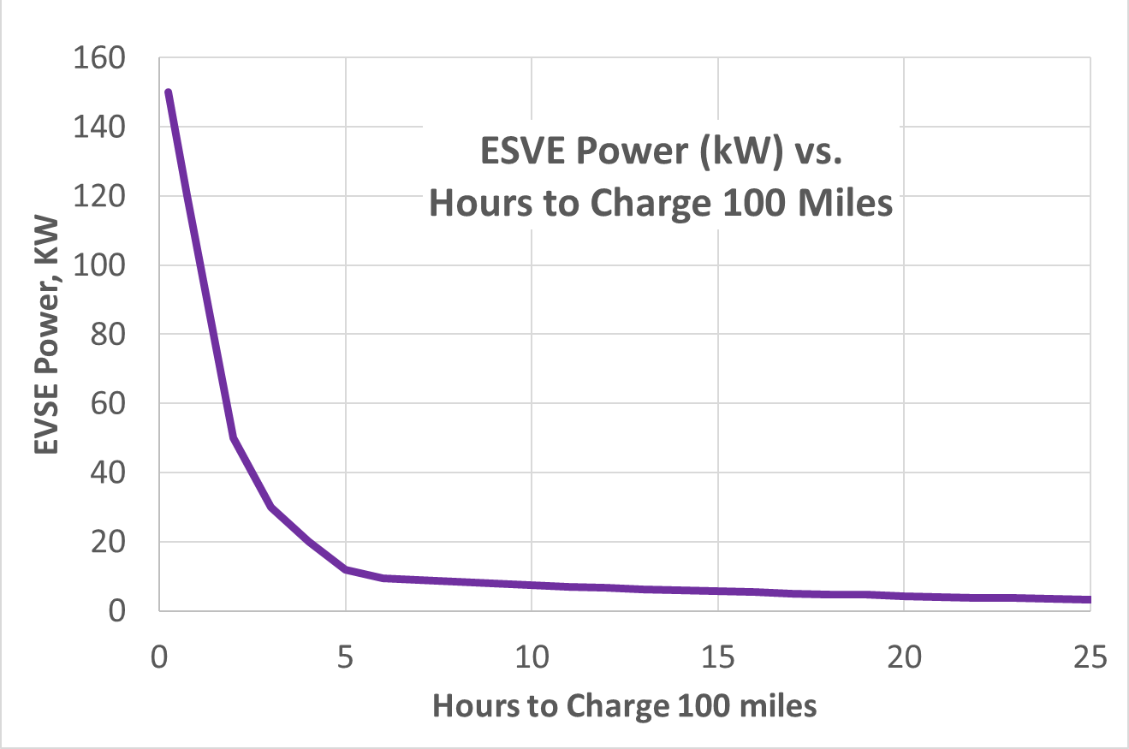
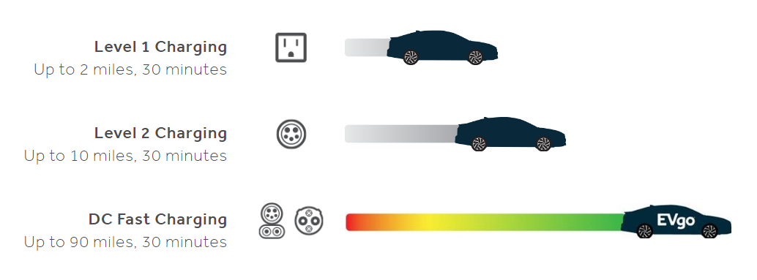
Charging Level vs. Charging Rate 100-mile range
Level 3
Power = Voltage x Amperage
kW = V x A
Level 1
Level 2
Level 1: → 1 to 2 kW: 16 to 24 hours – 100 miles
Level 2: → 3.3 to 19 kW: 4 to 12 hours - 100 miles
Level 3: → 25 - 150 kW : 10 min to 4 hours -100 miles
kW= kilowatt

Slide 15
EVSE Ownership & Revenue
Ownership Types
Facility
Third party
EV owner
Combinations
Fee models
No charge
Pay by event (flat fee)
Pay by time ($/hr)
Pay by kilowatt hour ($/kWh) – best analog to gasoline
Revenue Models
Use one of fee models
Cover cost of electricity plus overhead and profit
Amortize investment
Tax credits
Depreciation
Incentives
Good ROI requires regular use and fair rate plan

Slide 16
EVSE Ownership & Revenue
Example
Cost of electricity is $0.11/kWh
Battery holds 240 miles ~ 60 kWh battery
9.5 hours to charge (Level 2) 60 kWh x $0.11/kWh
→ $6.6 fuel cost → 3 cents/range mile → 70 cents /hour connected Common range of retail - $1.00 to $2.00 per hour connected
COMPARE: Gasoline vehicle for same application @$3/gal and 30 mile/gallon and 240 mile
→ $24 in gasoline →10 cents/ range mile
Retailer Charger Owner: Consider price between 3 and 10 cents/mile but most people charge at home &/or work → constrains price
For Level 3: charge by $/kWhr

Slide 17
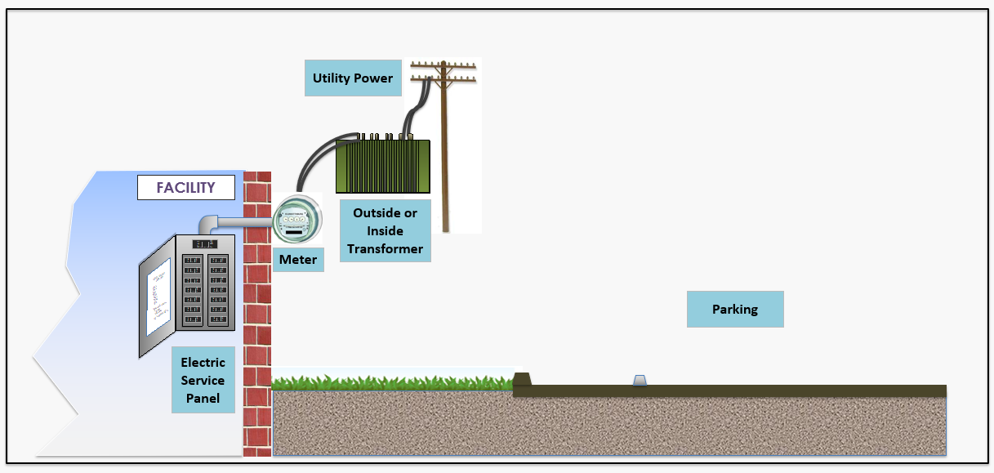
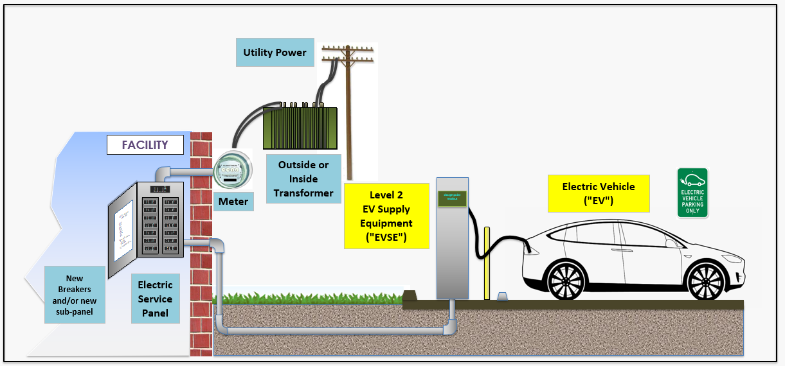
Typical Level 2 Charging Installation

Slide 18
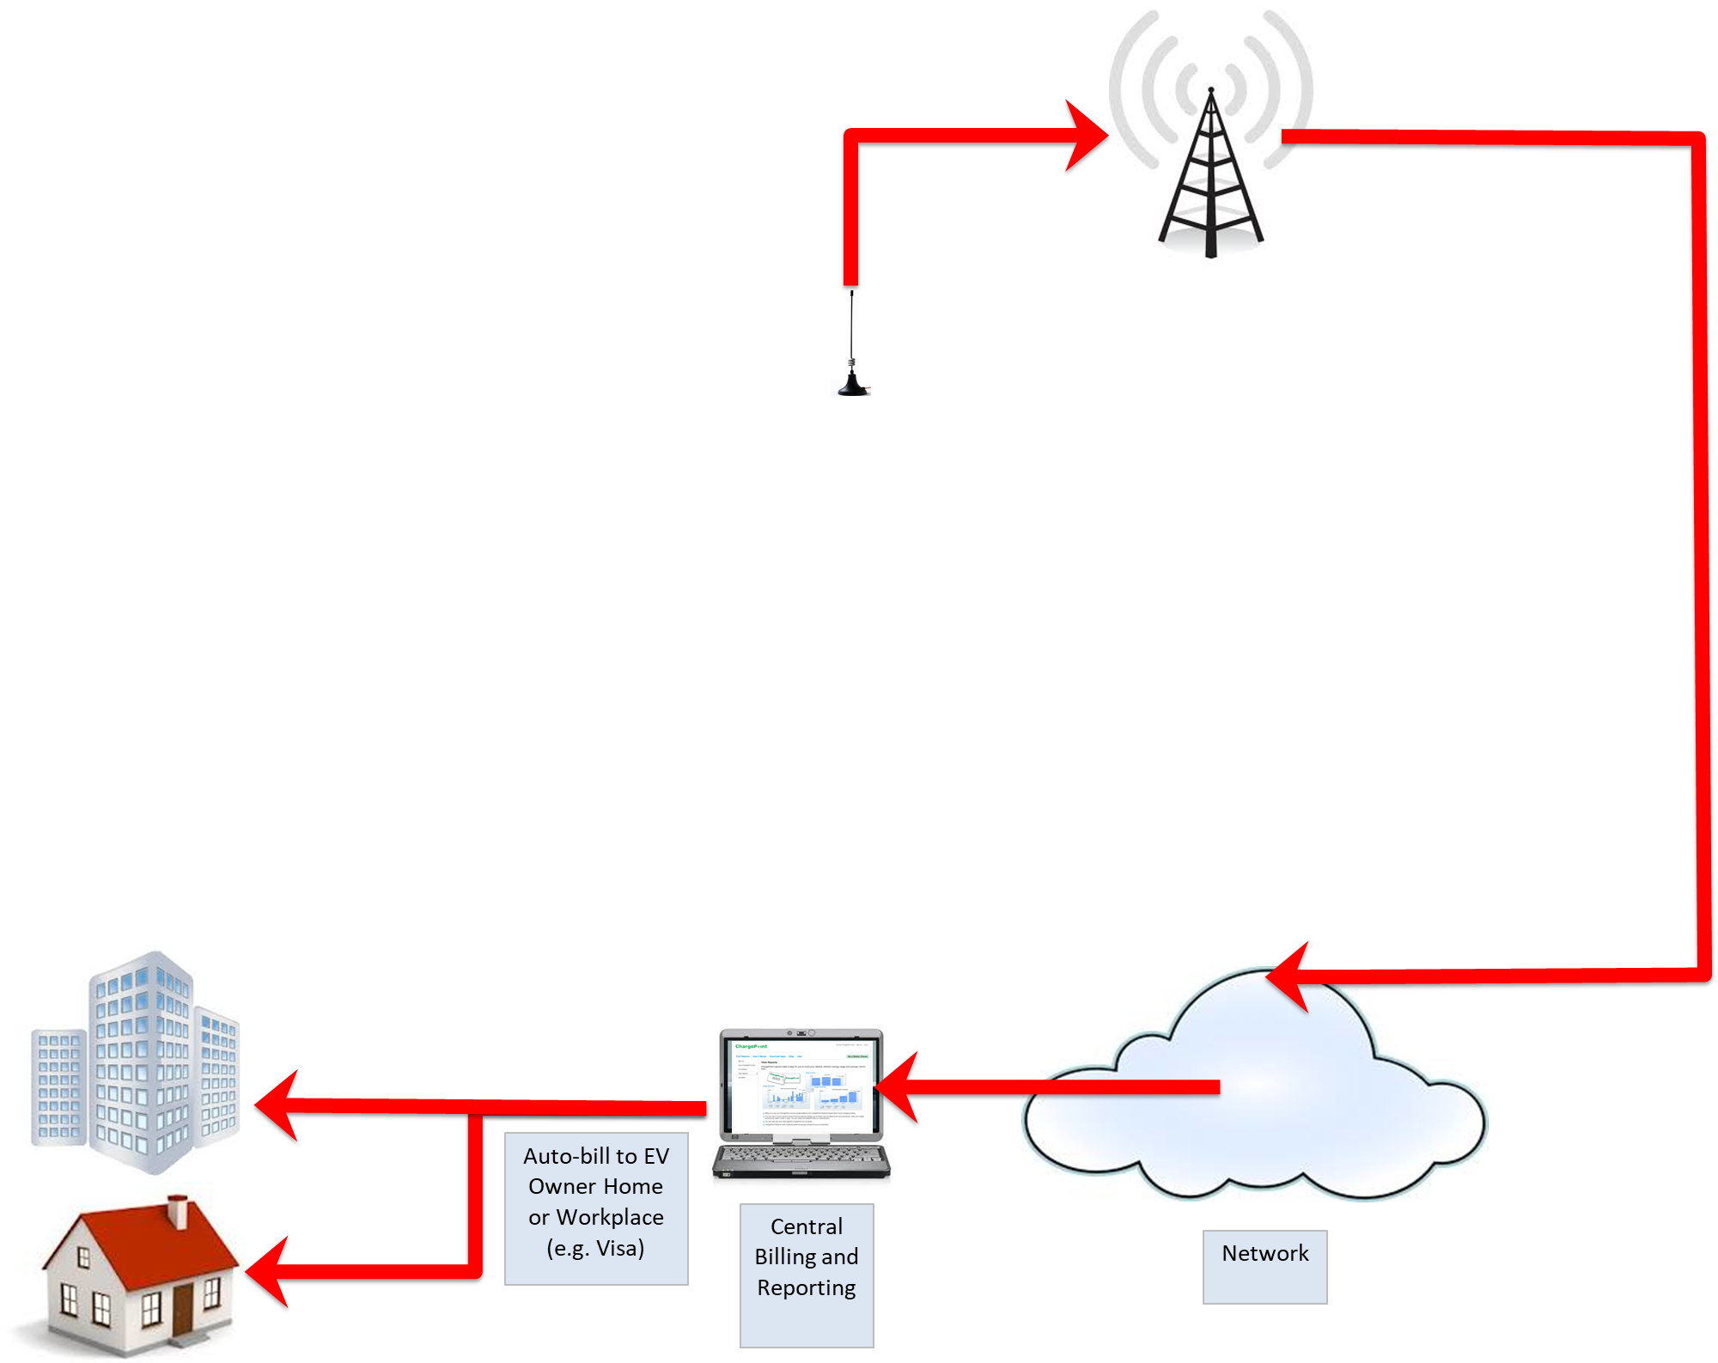
Typical Level 2 Charging Installation

Slide 19
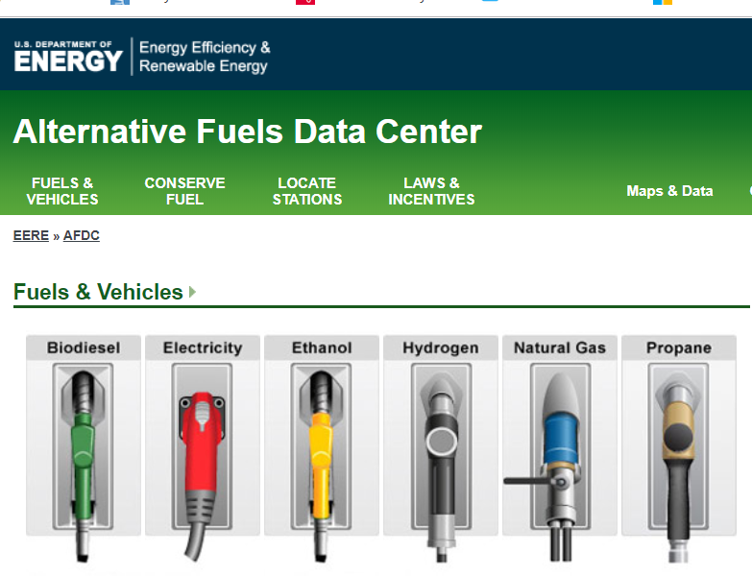
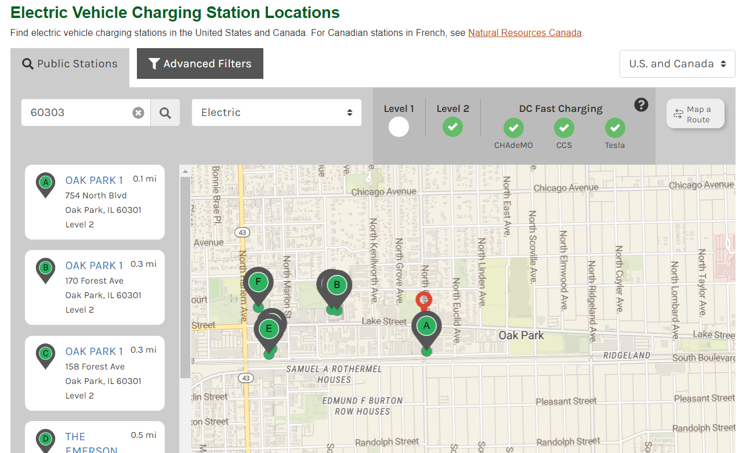
Siting and Finding EVSEs
Alternatives:
https://www.plugshare.com/
https://na.chargepoint.com/charge_point
https://afdc.energy.gov/

Slide 20
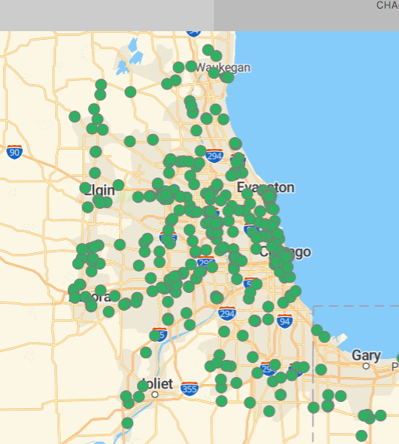
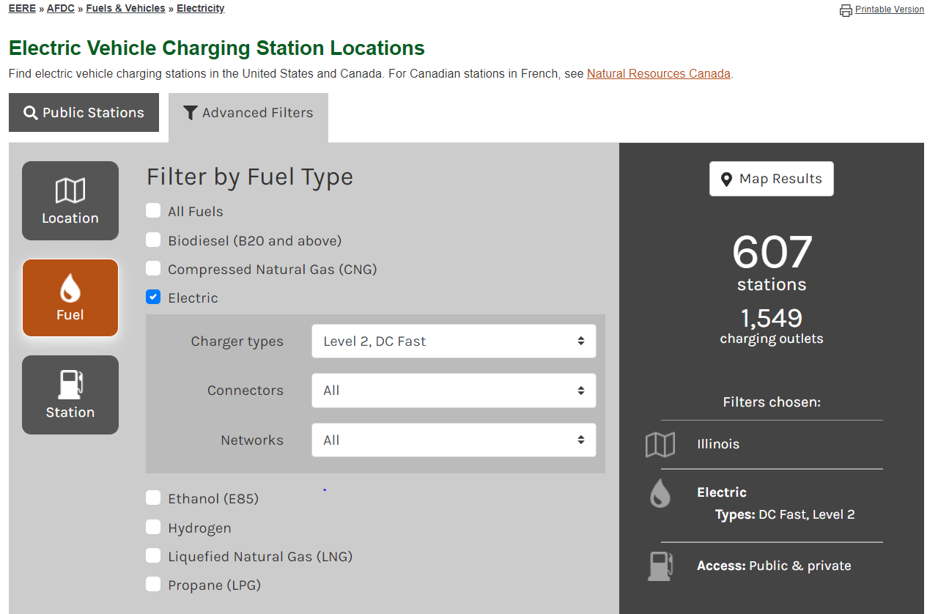
Siting and Finding EVSEs
https://afdc.energy.gov/

Slide 21
Who charges when and where?
> 80% of EV drivers charge at home (US)
Most EV drivers use public EVSE, wide range of use cases and frequencies
Urban vs. suburban vs. rural
Access /proximity to EVSE
How many miles per day?
EV type
In City of Chicago, 70% of people live in Multiple Unit Dwellings
Installed EVSE doable, but can be expensive to run electrical circuit
Some residents would buy EVs if EVSE located nearby (e.g. publicly or privately owned)
Cost to retrofit building to EV-enabled can be significant
Currently – limited number of proximal public chargers
Retail locations can be successful – ”Charge and Shop/Dine”
Lot’s of questions: Where to site? Where are EVs? How to site areas of EV charging gaps but prevent stranded assets? How to assess EV density factor? What kinds of effective public programs? ….

Slide 22
Siting EVSEs
EV Charging Station = Field of Dreams?
If you build stations will people charge?
Need EVs to support investment in chargers
Public-private collaboration – fleet charging open to public
If using public funds, consider regional and local sites that provide the best coverage, access and economics
Public roadways and state and federal programs
DC Fast Charger every 100 miles
Identify gaps in current EVSE availability and site logically
Avoid stranding assets – planning drives success
Social equity - define and deploy smart public programs

Slide 23
What is EV Ready?
Dialogue

Slide 24
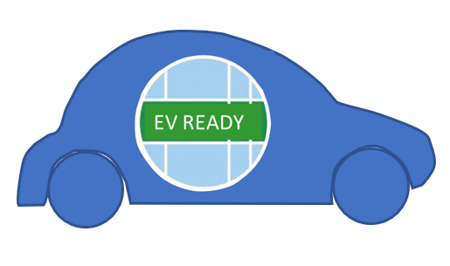
What is EV Ready?
Strategic Planning
Managing Barriers to Entry
Policy Making
New construction
Codes
Sustainability
Actions & Processes
EV and EVSE selection
Financial investment
Operations
Facility Designs and Siting
Inspection & Permitting
Risk and Safety
Knowledge and Education
Future proofing

Slide 25
What are the key planning considerations?
Where to locate public EVSE?
Strategic EVSE partnerships?
Connecting regionally?
Infrastructure and space?

Slide 26
What development policies need to be considered?
Parking?
Zoning?
EV Ready new construction?

Slide 27
What building codes, permitting & inspection policies need to be considered?

Slide 28
What pricing and finance issues need to be considered?
Public EVSE ownership?
Procurement decisions?
Pricing? Maintenance?

Slide 29
What information & training is needed?
Building & planning staff?
First responders?
Fleet & finance managers?

Slide 30
What needs to be considered to electrify municipal fleets?

Slide 31
What would you like to see in an EV/EVSE ‘buying decision guide’ for municipalities?

Slide 32
Next Steps
Designing an EV Ready Program by May 2020
Listening Sessions
Survey
Draft EV Ready Checklist/ Framework
EV Ready Buying Decision Guide
Communications
Inform about policies and incentives

Slide 33
Thank you!
Edith Makra
Metropolitan Mayors Caucus
312-201-4506
emakra@mayorscaucus.org
Cheryl Scott
312-386-8654
cscott@mayorscaucus.org
Tim Milburn Green Ways 2Go
847-826-3314 tim.milburn@greenways2go.com www.greenways2go.com

