Slide 1
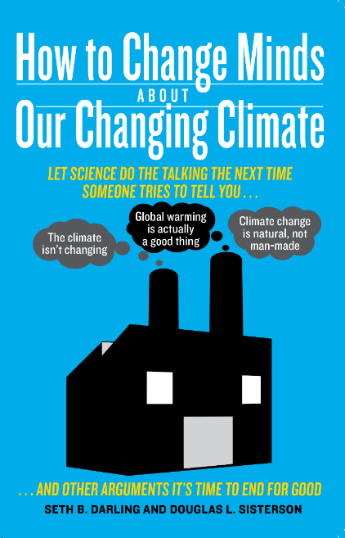
Climate Disruption What We Can Do
Seth B. Darling, PhD

Slide 2
Our options
Mitigation
Geoengineering
Adaptation

Slide 3
Our options

Slide 4
Our options
Adaptation
Plan for impacts
Build resiliency
Improve response capacity

Slide 5
Our options
Fertilizing the ocean
Adding minerals to ocean to enhance its CO₂ absorption
Accelerating rock weathering (dissolves CO₂)
Capturing CO₂ from air
Planting forests
Deploying space mirrors
Injecting aerosols into stratosphere
Seeding marine clouds
Brightening ocean with microbubbles
Growing reflective crops
Whitening rooftops
Absorb CO₂
Reflect sunlight
Geoengineering

Slide 6
Our options
Mitigation
Reduce emissions

Slide 7
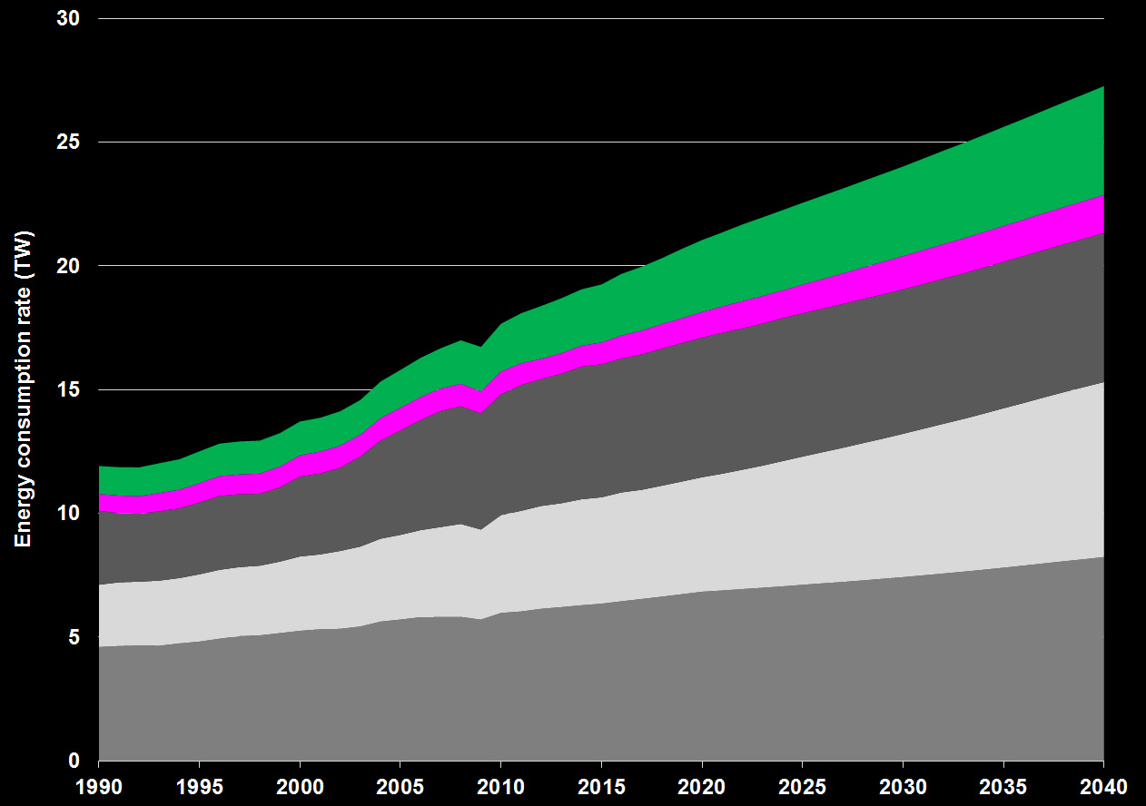
Projected low-carbon contribution is far too small
Need >10 TW of renewables by 2050
other
biofuel
hydro
renewables
~10
TW
renewables
nuclear
coal
nuclear
natural gas
fossil fuels
liquid fuels
EIA 2016

Slide 8
Feasible limits…
Fossil fuels
>30 TW
Nuclear fusion?
Biomass
5 TW
Nuclear fission
>30 TW
Biomass
5 TW
Fossil fuels
Wind
10 TW
Wind
10 TW
Oceans
<1 TW
Geothermal
<1 TW
Hydropower
2 TW
Global energy demand in 2017
19 TW
Today…

Slide 9
What about when my son is middle aged?
Fossil fuels
>30 TW
Nuclear fusion?
Biomass
5 TW
Fossil fuels
Nuclear fission
>30 TW
Biomass
5 TW
Wind
10 TW
Wind
10 TW
Oceans
<1 TW
Geothermal
<1 TW
Hydropower
2 TW
Projected scenario
Max only renewable scenario
Global energy demand in 2050
30 TW
(without solar)

Slide 10
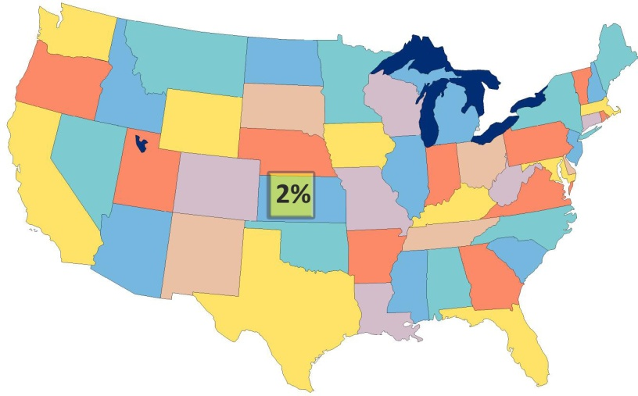
Average conversion efficiency of 12%
Collect over 2% of land
Total striking
land/ocean
96,000 TW
Land area = 29.2% of Earth
28,000 TW
560 TW
67 TW

Slide 11
Solar
67 TW
Other renewables
Global energy demand in 2050
30 TW
Global energy demand in 2050
30 TW

Slide 12
Solar panel prices
have plummeted
Notes:
Richard Swanson (SunPower)

Slide 13
Illinois power plant emission pathways

Slide 14
darling@anl.gov
Notes:
Our atmosphere is a razor-thin, delicate layer protecting our planet…we should treat it with respect and care

