Slide 1
Mobility Management: History, Current Practice, and Opportunities for ADA Professionals
March 21, 2017
ADA Coordinators Group
Metropolitan Mayors Caucus

Slide 2
Today’s Topics
Introduction
NCMM and FTA
NCMM Mission and History
Introduction to Mobility Management
What is Mobility Management?
Who is a Mobility Manager?
Mobility Management Process
National Trends and Case Studies
Q&A

Slide 3
National Center for Mobility Management
We Can Help You Make Connections
The mission of the National Center for Mobility Management (NCMM) is to facilitate communities to adopt transportation strategies and mobility options that empower people to live independently and advance health, economic vitality, self-sufficiency, and community.
National Center for Mobility Management

Slide 4
About the NCMM
National technical assistance center
Launched in early 2013
Jointly operated by three national organizations:
Easterseals
American Public Transportation Association
Community Transportation Association of America
Cooperative Agreement with the Federal Transit Administration, USDOT

Slide 5
Introduction to Mobility Management
What is Mobility Management?
Innovation in transportation service and coordination
Local and regional solutions to fit community need
Assist those that face transportation challenges
Youth
People with disabilities
Aging populations
English language learners
Those with limited income
Networked services to provide solutions to those above

Slide 6
Introduction to Mobility Management
History of Mobility Management
Transportation services were offered in an era of:
Smaller communities
Less sprawl
Consumers with predictable needs
Transportation/transit success measured by:
Efficiency, effectiveness and overall productivity
Transportation as product, not solution

Slide 7
Introduction to Mobility Management
History of Mobility Management, continued
In 2003, a shift in perspective
Quality of customer experience
Operational issues are still important, but subordinate
Quality is more important than territorial concerns of equipment and service
The last decade has seen change, but process ongoing

Slide 8
Introduction to Mobility Management
History of Mobility Management, continued
In 2003, a shift in perspective
Quality of customer experience
Operational issues are still important, but subordinate
Quality is more important than territorial concerns of equipment and service
The last decade has seen change, but process ongoing

Slide 9
Mobility Management: Coordination of People and Transportation Providers
Mobility Managers Work In
Non-profits, AAAs, Community Action Agencies, Aging & Disability Resource Centers, Schools, Higher ED, Governmental agencies, Workforce Development, Hospitals, Fed Qualified Health Centers, Food & Nutrition Programs, Faith-Based Service Organizations
Human Services
Transit-Mobility providers
Public – fixed route providers, private agencies & providers – NEMT providers – Planning organizations

Slide 10
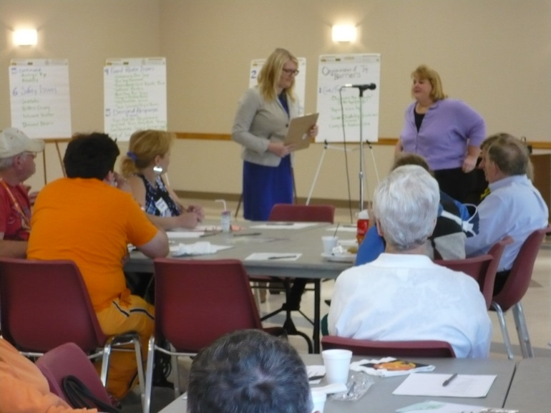
Introduction to Mobility Management
Who is a Mobility Manager?
A problem solver
An advocate for those who need transportation
A facilitator of groups
A teacher, communicator and cheerleader

Slide 11
Introduction to Mobility Management
What does a mobility manager do?
Builds networks
Transportation providers and planners
Workforce development and educational agencies
Healthcare agencies
Elected officials
Understands the population they’re advocating for
Environmental scan, inclusive planning, and solicitation of feedback

Slide 12
1. Begins with a full understanding of customers’ transportation needs
5. Ensures customers can provide feedback on the solution so it remains relevant and useful
2. Brainstorms a potential solution that matches this understanding with the range of available or possible services
4. Empowers customers to connect to the solution
3. Engages one or more partners in providing the solution in a coordinated manner

Slide 13
Understanding Individuals’ Needs
Individual and group discussions
Family information
Information from agencies/organizations
The goal:
Formalize the knowledge you collect about those you’re working to find solutions for
Makes you a better advocate, solutions more reachable

Slide 14
Individualized Transportation Needs Assessment Tool
Document available to you here
Six steps:
Current transportation options
Where and when?
Mobility considerations
ADA eligibility
Community transportation options
Ability to pay?

Slide 15
Step 1: Current transportation options
Private vehicle
Shared rides
Public transportation services

Slide 16
Step 2: Trip Needs and Details
Type of destination?
Purpose of trip impacts choice of service from available options
Helps prioritize within community or volunteer programs
Record all details
Who will be traveling?
Time?

Slide 17
Step 3: Considerations for Mobility
Basic traveling skills
Functional, sensory, and intellectual or cognitive considerations
Disabilities that are not apparent
Culture, language and other personal issues

Slide 18
Step 4: Eligibility for Paratransit Services
Eligibility for ADA-complementary paratransit services
Type of appropriate transportation services
Shared?
Alternative modes?

Slide 19
Step 5: Applicable Transportation Options
Applicable routes
Cost
Accessibility
Type of service
Advance reservation requirements

Slide 20
Step 6: Ability to Pay
Current expenditures on transportation
Amount individual is able to comfortably budget
Amount of additional funds necessary
Resources to help pay for transportation
Listen to their concerns, goals, and ability to obtain additional resources

Slide 21
Assessing Groups of Riders
Destination
Origin
Agency/organization
Built in network to utilize
Source of education on your community and neighbor needs

Slide 22
Working With Specific Populations
People with disabilities
Job seekers and limited income
Medical trips
Older adults
Military veterans
Other
Social groups
English language learners

Slide 23
People with Disabilities
Disability intersects with other populations
Disability status may come with funding/assistance
Some facts:
In 2003, half a million were homebound
In 2012, 34% employment v. 83% w/o disability
Not all of this is owed to transportation, but it plays a role

Slide 24
The ADA and Transportation
Passed 1990, amended in 2008
Designed to:
Give civil rights protections to and eliminate discrimination against individuals with disabilities
Eliminate barriers those with disabilities face in the public arena
Dept. of Justice ADA website: www.ada.gov

Slide 25
The ADA and Transportation
Passengers’ Rights
Use any publicly funded bus or rail system
Expect reasonable accommodations
Receive complementary paratransit service if 1 of 3 eligibility categories are met
Finally – right to file complaints if any of the above isn’t adhered to

Slide 26
Title VI – Transportation Implications
Civil Rights Act of 1964
Based on race, color and national origin
Most recent circular is 4710.1
Not just service, but planning participation too
What was missing from ADA?
More on this later!

Slide 27
Mobility Funding for People with Disabilities
FAST Act 5310
Enhanced Mobility of Seniors & Individuals with Disabilities
55% capital/45% operating, marketing and alternative transportation services
80% federal/20% local match
Social Security Administration Programs
Plan for Self Sufficiency (PASS), Impairment-Related Work Expense (IRWE), Blind Work Expenses, etc

Slide 28
Service Strategies for People with Disabilities
Fixed-route services (w/ travel instruction)
Demand-response/subscription services
Local disability services agencies
Nonprofit organizations
Volunteers, church groups, etc.
Private providers
Ridesharing

Slide 29
Travel Training Continuum
Travel training may be necessary (continuum)
Written guide
On-line video instruction
In-person/on-site orientation
Group intro
Bus buddy system
Intensive Travel Training

Slide 30
Environmental Scan and Network Building
Objectives
Outline different “customer” groups mobility managers interact with
Introduce concept of environmental scan
Needs of community
Available services
Introduce individual and community assessment tools and their potential use scenarios

Slide 31
Who are your “customers”?
Individual riders and their caregivers
Particular groups of individuals
General public
Rural communities
People with disabilities
Aging populations
Agencies and transportation providers
Your mobility management network

Slide 32
Referrals from Agencies/Organizations
Referral protocol
Case managers do assessment described earlier
Share results with mobility manager
Mobility manager assists in problem solving, connections
Formal system
Based on data from missed appointments, where available

Slide 33
Referrals from Agencies/Organizations
Referral protocol
Case managers do assessment described earlier
Share results with mobility manager
Mobility manager assists in problem solving, connections
Formal system
Based on data from missed appointments, where available
Important to consider solution that respects privacy

Slide 34
Agencies/Organizations as Customers
Human service/workforce development agency
Share information on services
Process for collecting data on unmet needs
Reducing customer missed/late appointments
Businesses and employers
Nonprofit organizations

Slide 35
Mobility Management Network as Customer
Members of your network are you customer
How does transportation fit into their work?
What is their capacity for focus on transportation?
Partner in education?
Their concerns for their clients
Desire to see client/individual needs met
Standards adhered to

Slide 36
National Trends
TNC/Shared-Use Pilot Programs
Expanding Statewide Networks
Inclusive Planning

Slide 37
National Trends – TNC/Shared Use
Lyft pilot programs
Brookdale Senior Living Solutions
Limited pilot
Use of service without app via concierge
Charges directly to resident bill
Pilot came about through direct resident involvement
What needs are unmet, where is opportunity?
Blue Cross Blue Shield
Pharmacy connections in transportation deserts in Chicago
Appointment rides in certain areas of Pittsburgh
Still in development

Slide 38
National Trends – TNC/Shared Use
Key questions remain
Equity in practice
Local constituency/ability to enforce
Strategies for adoption
Seek all partners
Transportation not limited to government entities

Slide 39
National Trends – Expanding Networks
Ohio Mobility Management Program
Similar to other state networks
Wisconsin
Maine
Michigan
Not just for transportation officials!
Area Agencies on Aging, Disability Rights Groups

Slide 40
National Trends – Expanding Networks
What could this look like in Chicago region?
Connections to all RTA services
Volunteer and Human Service Connections
Across muni borders
Share resources, share benefits
Barriers to cooperation?

Slide 41
National Trends – Inclusive Planning
Administration for Community Living
Transit Planning 4 All
25 Demonstration Programs
Not just about compliance
OSU – Nisonger Center
Personal mobility technology
People with cognitive disabilities were focus
Inclusive Planning
Design *from* and not *for*

Slide 42
Tap into Resources
National Center for Mobility Management
National Aging and Disability Transportation Center
National Rural Transit Assistance Program
ACL Transit Planning 4 All

Slide 43
Take Advantage of Our Resources
Webinars, Newsletters, Products
Mobility Management & Information Practices Database (MMIP)
Technical Assistance – ask your liaison
Link to Liaisons

